Slide 2

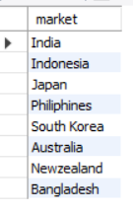
Provide the list of markets in which customer "Atliq Exclusive" operates its business in the APAC region.

Slide 3
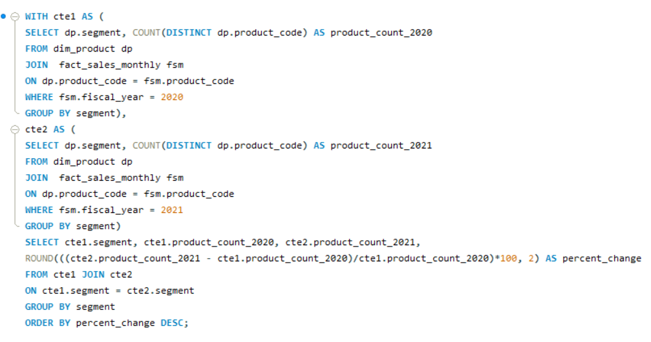
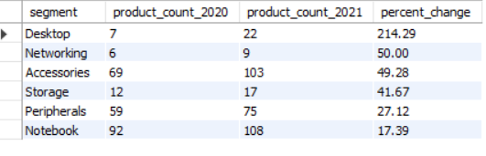
What is the percentage of unique product increase in 2021 vs. 2020? Thefinal output contains these fields,
unique_products_2020
unique_products_2021
percentage_chg

Slide 4
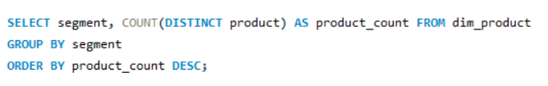
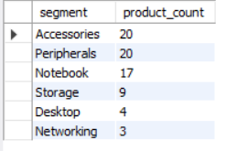
Provide a report with all the unique product counts for each segment and sort them in descending order of product counts. The final output contains 2 fields,
segment
product_count

Slide 5
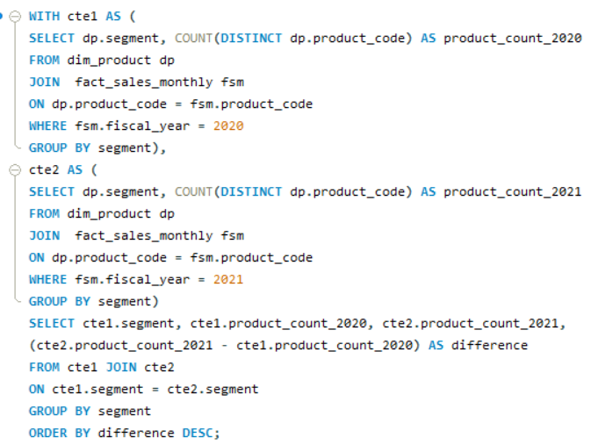
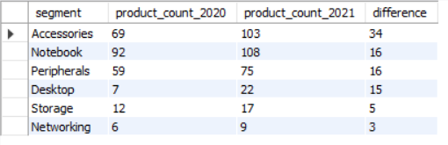
Follow-up: Which segment had the most increase in unique products in 2021 vs 2020? The final output contains these fields,
segment
product_count_2020
product_count_2021
difference

Slide 6
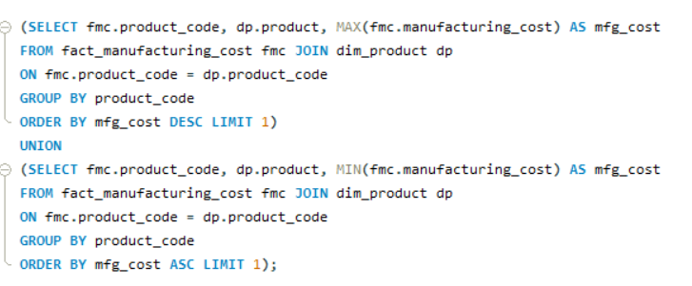

Get the products that have the highest and lowest manufacturing costs.The final output should contain these fields,
product_code
product
manufacturing_cost

Slide 7
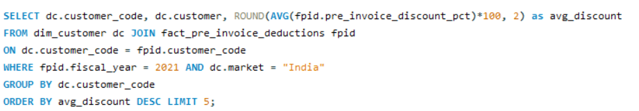
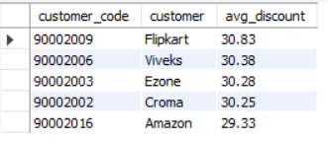
Generate a report which contains the top 5 customers who received an average high pre_invoice_discount_pct for the fiscal year 2021 and in the Indian market. The final output contains these fields,
customer_code
customer
average_discount_percentage

Slide 8
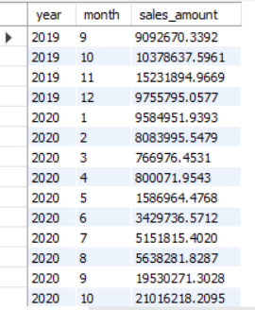
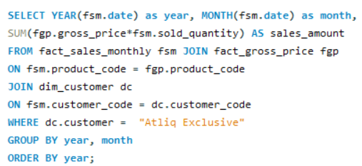
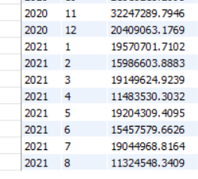
Get the complete report of the Gross sales amount for the customer “AtliqExclusive” for each month. This analysis helps to get an idea of low and high-performing months and take strategic decisions. The final report contains these columns:
Month
Year
Gross sales Amount

Slide 9
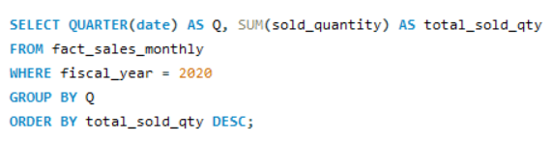
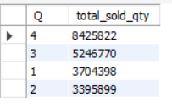
In which quarter of 2020, got the maximum total_sold_quantity? The finaloutput contains these fields sorted by the total_sold_quantity,
Quarter
total_sold_quantity

Slide 10
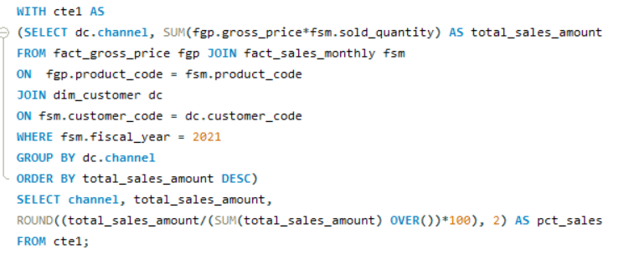
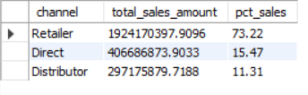
Which channel helped to bring more gross sales in the fiscal year 2021 and the percentage of contribution? The final output contains these fields,
channel
gross_sales_mln
percentage

Slide 11
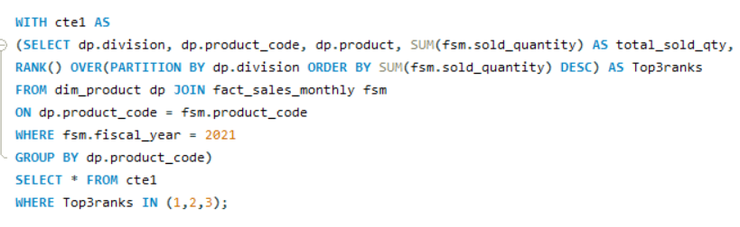
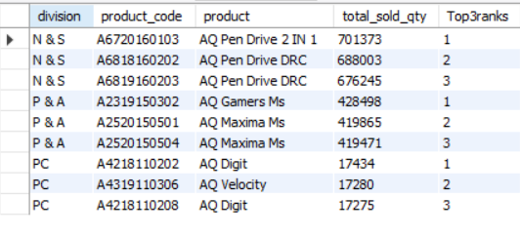
Get the Top 3 products in each division that have a hightotal_sold_quantity in the fiscal_year 2021? The final output contains these
fields,
division
product_code
product
total_sold_quantity
rank_order

